Slide 1

Social media, gaming and your child
Primary
Notes:
Social media and online video gaming is a large subject to cover in one hour.
The key is to give parents and carers a brief introduction to social media and online video gaming, followed up with tips and resources.
If parents or carers have questions or comments, have them write them down on their note paper so they can be discussed, time permitting.
Also please make the distinction between gaming (as in gambling, which is not covered here) and video gaming (which is the subject for our workshop).

Slide 2

What are social media apps?
Applications that give access to social media
These applications are embedded in apps, video games, websites and even learning environments
Notes:
Social media is becoming increasingly embedded in apps, games, websites and even learning environments.
Social media apps are applications that give children access to social media.
When children use social media, they upload and share content.
Children can use social media to create online profiles, post comments or chat, upload photos and videos, share links, tag photos and content, create and share video game modifications, remix or change existing content and share it, and more.
Social media is becoming increasingly embedded in apps, video games, websites and even learning environments.
It may be difficult to ban social media access and we will focus on how to navigate social media risks and behave respectfully.

Slide 3








Different types of social media
Social networking: Facebook.
Anonymous social networks: Ask.fm, Sarahah.
Blogging: Tumblr, Medium.
Bookmarking: Pinterest, Flipboard.
Photo sharing: Instagram, Snapchat.
Video sharing: YouTube.
Discussion forums: Reddit, Quora, Digg.
Consumer review networks: Yelp, TripAdvisor.
Social shopping: Etsy.
Sharing economy: Airbnb, Uber.
Notes:
There can be overlap in the different types of social media.
There can be overlap between social media and video gaming interactions.
Online multiplayer video games also allow children to chat and share.
With young people a new industry target, many companies are creating social media platforms in order to engage young people early on.
A recent example of this is Facebook Messenger for Kids, an app targeting under 13s,

Slide 4
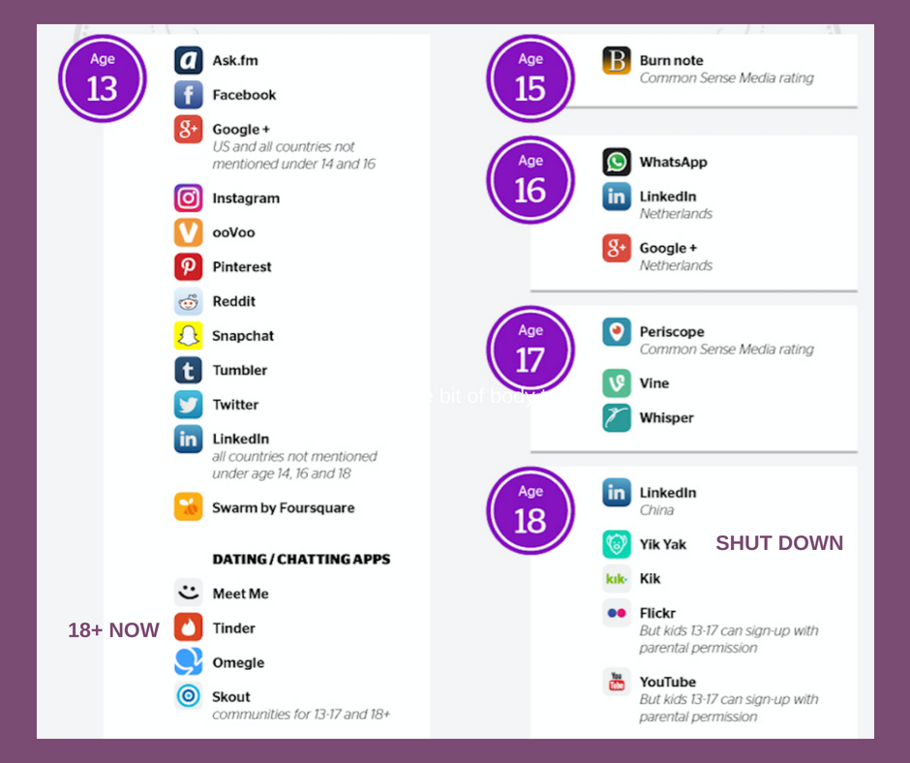
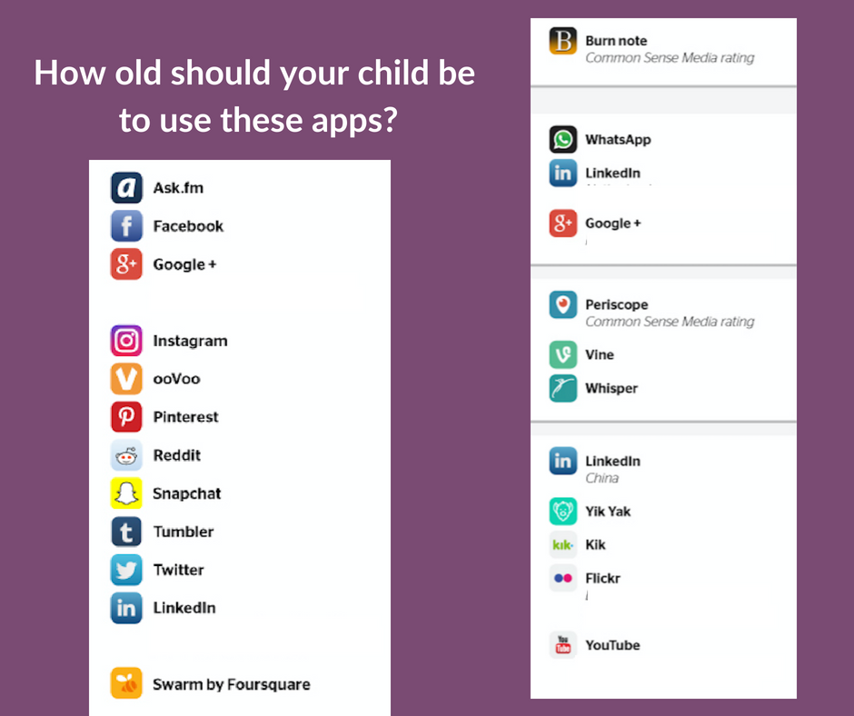

Identifying key social media apps
Notes:
Slide 1: what social media apps do you know
Slide 2: show social media apps
Slide 3: show same slide, but indicate age limits
Many parents and carers may know social media platforms, but they do not necessarily know the age limits for certain social media apps.
Click on the screen to display another image on this Slide 4. This image will display several of the more popular social media apps, then the next image will show which apps are for children aged 12 and under.
Slide 4 has 3 slides in 1 – If you click on the screen, the images will change, but this will still be contained in Slide 4.

Slide 5
What are the benefits of using social media?
Social fun
Creative fun
Share interests
Develop relations and extend offline interactions
Share educational content
Notes:
Social media is a fun aspect of children’s social and creative lives.
Children can use social media to have fun, make new friends, share interests, develop relationships and more.
Social media can be an extension of children’s offline and face-to-face interactions.
Children can use social media to share educational content.
Exploring and experimenting on social media sites can help children build their knowledge and skills to use technology safely and responsibly.
Collaborative learning is one use of social media sites within the school setting.

Slide 6
What are the risks of social media?
Exposure to inappropriate or upsetting content, such as mean, aggressive, violent or sexual comments or images
Inappropriate content like embarrassing or provocative photos or videos of themselves or others
Sharing personal information with strangers – for example, phone numbers, date of birth or location
Being bullied or targeted for advertising and marketing
Notes:
Children may be exposed to inappropriate or upsetting content, such as mean, aggressive, violent or sexual comments or images.
Children may upload inappropriate content such as; embarrassing or tasteless photos or videos of themselves or others.
Children may share personal information with strangers – for example, phone numbers, date of birth or location.
Children may be bullied online.
Children may be targeted for advertising and marketing, some of which may not be age-appropriate such as the advertising of gambling websites, or be vulnerable to data breaches, i.e. having their data sold on to other organisations.
As with any use of internet and technology, there are risks associated with that use. Parents and carers need to understand how to use the internet responsibly and then show their child/children how to navigate online.
It is understandable that many parents and carers may feel that this is beyond them, but there are many resources available and the later slides will provide support.
According to a 2017 Gambling Commission survey of 11-16 year olds, 70% of young people have seen gambling adverts on social media and 10% follow gambling companies on social media.

Slide 7
Strategies for reducing risk on social media sites
Have a conversation with your child/children
Discuss the risks involved in using social media
Explain the dangers involved in sharing content and personal information
Teach your child/children how to respond if people are inappropriate
Discuss the various ways social media may expose your child to inappropriate advertising
Notes:
Have a conversation with your child/children and work out how they want to behave and be treated by other people online.
Discuss the risks involved in using social media – for example, risks like being tagged in an embarrassing photo taken at a party.
Explain the dangers involved in sharing content and personal information. This includes not only content that your child/children share(s), but also images of your child/children that other people share, or posts and images where your child/children are tagged.
Teach your child/children how to respond if people ask for personal details, are mean or abusive online, post embarrassing photos of them, or share their personal information.
Discuss the various ways social media may expose your child to inappropriate advertising.
Talking about social media use is one of the best ways to protect your child/children and teach them to use technology responsibly.

Slide 8
Parental controls and social media
According to Ofcom (2015)
  67 % of five to seven year olds
  91 % of eight to 11 year olds
  98 % of 12 to 15 year olds use online services
Age restrictions may not work
Parental controls may provide some guidance for younger children
Notes:
According to Ofcom (2015), 67 per cent of five to seven year olds, 91 per cent of eight to 11 year olds and 98 per cent of 12 to 15 year olds use online services, and there are “walled garden” services – Moshi monsters - http://www.moshimonsters.com/home/, Disney Club Penguin - https://www.clubpenguinisland.com/, CBeebies - https://www.bbc.co.uk/cbeebies. (A walled garden shields users from certain kinds of information)
The age restriction on many social media platforms is meant to deter younger children from creating social media accounts, but we know that may not work.
Parental controls on phones and computers may allow parents and carers to provide some guidance for younger children.
It may be difficult to block social media access for younger children and if you do ban it altogether, they might be more tempted to check it out.
Your child’s/children’s access to the internet may be difficult to control as their classmates or even a Wi-Fi-enabled café can provide access.

Slide 9



How to report on social media
If you are suspicious about someone's behaviour towards a child, contact CEOP.
If you see any criminal content, contact Internet Watch Foundation.
Childnet International discover how to report on several platforms.
Notes:
If you see content that is harassing, pornographic or violent, you can report to the social media site directly.
If you are suspicious about someone's behaviour towards a child, report it to CEOP. (CEOP is the Child Exploitation and Online Protection command and you can go to https://www.ceop.police.uk/safety-centre/ for more information.
If you see any criminal content you should report it to the Internet Watch Foundation. (The IWF is an independent not for profit organization that works to make the internet safer by removing images of child sexual abuse. You can go to https://www.iwf.org.uk/ for more information.)
Most social media platforms have guidelines about the content they allow on the site. If content breaks the rules, users are encouraged to report it so that the platform can maintain the community.
You can follow the links in this Childnet International page - https://www.childnet.com/resources/how-to-make-a-report/ to discover how to report on several platforms.

Slide 10

What is online gaming?
Online gaming refers to video games played online, as opposed to gaming in the form of gambling
Played on a variety of devices
Children may play video games with players they don’t know
Notes:
Online gaming refers to video games played online, as opposed to gaming in the form of gambling.
These video games are played on a variety of devices and offer competitive or collaborative worlds to visit with many other players.
Children will play these video games with players they don’t know, and can often interact with them through voice, text and sharing pictures.
The rise in popularity of these video games can put pressure on children (even those who don’t particularly want to play) to take part.
Children will often use these video games to chat socially and exchange news about school, friends and homework.
There has recently been a blurring of the lines between online video gaming and gambling, as users are able to pay money to earn chances to win online prizes or tokens. Although these don’t have monetary value and so aren’t considered gambling, there are some third party sites (often closed down by the Gambling Commission) which enable them to be sold online.

Slide 11

Different types of online video gaming devices
Consoles, like the Xbox, PlayStation and Nintendo Switch are usually played on a big screen
Tablets and smartphones are played on the go
Handheld devices like the 3DS and PlayStation Vita are less popular
All require an internet connection to play
Notes:
There are a range of devices that can be used to play video games online.
Consoles, like the Xbox, PlayStation and Nintendo Switch are usually played on a big screen.
Tablets and smartphones are played on the go but often offer the same video games.
Handheld devices like the 3DS and PlayStation Vita are less popular these days but are still used to play online video games.
These devices all require an internet connection to play video games, which can be via phone data, wireless or wired internet.
Boxed video games purchased physically require a PEGI rating in the UK, stating whether it is suitable for 3, 7, 12, 16 or 18 year olds. Online video game purchases don’t legally require a rating but Playstation, Xbox, Nintendo and Google voluntarily enforce a PEGI rating in their online stores. Apple have their own rating, but the Steam shop on PC/Mac is not rated.
Online interactions are not rated by the PEGI age rating as they are considered outside the control of the developer.
PEGI 12 video games could have online modes where players can hear swearing that, if included in the original video game rating, would have resulted in a higher rating.

Slide 12

Identifying key online video games
What online video games do you know?
What video games have you heard your children talking about?
Notes:
What online video games do you know?
Many parents and carers may know Fortnite, Minecraft or Roblox, but they do not necessarily know the age limits for certain video games.
Show slide 12 which will display several of the more popular video gaming apps, then the screen will show which video games are for children 12 and under.
Parents and carers are also usually unaware that user-generated content (such as many of the games in Roblox) fall outside the PEGI rating.
Online video games and gambling (users may gamble with online items used in video games, for example, skin gambling - https://parentzone.org.uk/article/what-skin-gambling) may be something children engage in. Clearly, children are not to be encouraged to gamble online in any form.
Some gambling sites have practice games where no money is wagered; these may have inflated win rates which may lead to unrealistic expectations of the ability to win.

Slide 13
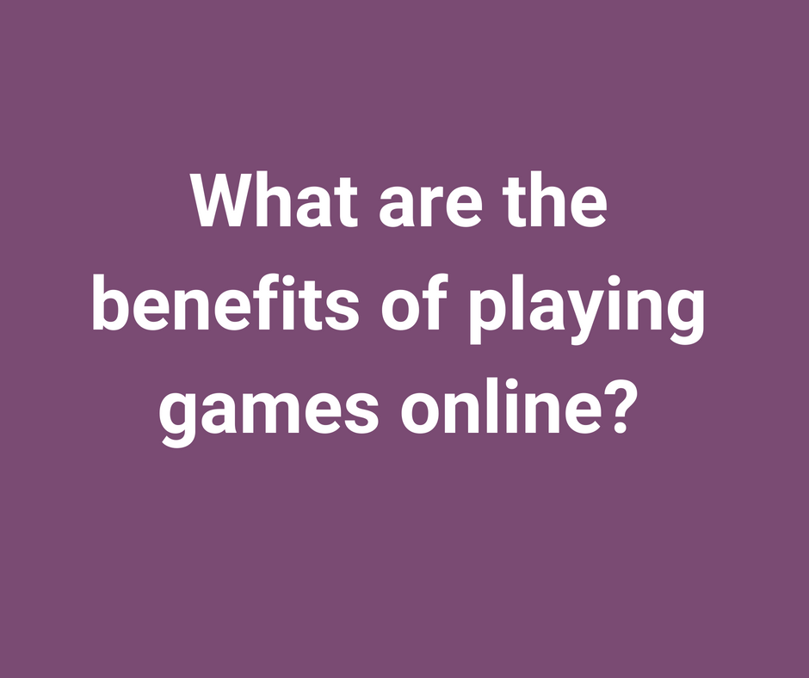
  problem-solving skills
  visual-processing skills
  processing speed
  multitasking
  increase memory power
  diversion and play
  improved socialisation
  increased teamwork
  a different world
Notes:
Playing video games may:
increase problem-solving skills
sharpen visual-processing skills
increase processing speed
increase the ability to multitask
increase memory power
provide a moment of diversion and play
improve socialisation skills through multiplayer video gaming
increase the ability to work in teams through multiplayer video gaming
offer a unique opportunity to experience a world through another person’s eyes
enable children to encounter cultures, languages and perspectives on the world different to their own.
Allow the parents and carers to discuss the benefits.
Some people consider video games to be art. It can be useful to consider the similarities and differences between gazing at a painting and exploring a beautiful world in a video game.

Slide 14
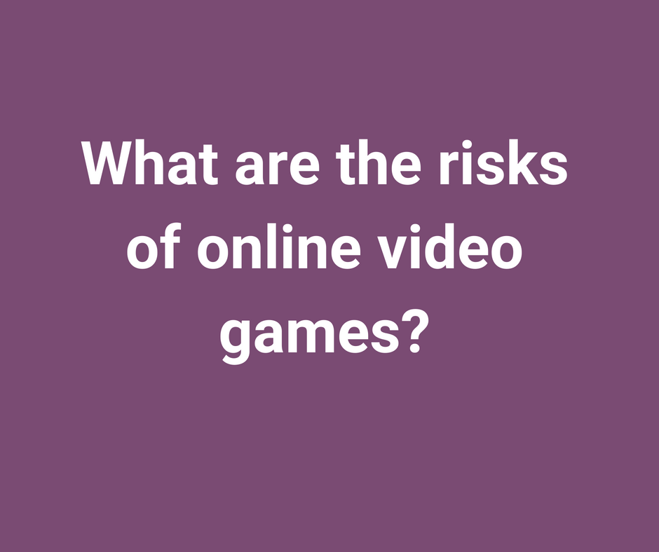
The online video gaming environment can be:
anonymous.
violent or dangerous.
a space for grooming or inappropriate contact.
abusive.
where offensive language is used.
a place with a bullying culture.
difficult to limit your gaming time.
a place to experience gambling.
the cause of health problems.
Notes:
The online video gaming environment is largely anonymous.
Video games may contain violent or dangerous content not suitable for younger viewers.
Children may be playing video games with people they do not know, which may make them vulnerable to grooming or inappropriate contact.
Children may be harmed by abusive players who destroy their creations, use offensive language or bully the gamer in other ways.
Children may not be able to self-regulate and set time limits on game play, leading to excessive use.
Children who play video games excessively may experience health problems such as back and neck pain, blurred vision, headaches and near-sightedness.
Children may experience gambling-like behaviours that trigger a desire to gamble in the real world. For example, you may pay money to spin a wheel that determines how good the virtual car you win is.
Allow the parents and carers to discuss the risks.
Identifying which risks can be anticipated and which are unexpected would be useful to discuss.
At any particular time there are specific risks in the news (like gambling), but it’s important for parents and carers to understand and discuss the full range (compulsive playing, inappropriate content, online strangers, general health) to guide their child/children to healthy habits with video games.
In 2015, the Gambling Commission identified the following risks with social gaming:
Problem gambling type risks (i.e. similar harms to problem gambling):
People, especially young people, spending large amounts of time
People, especially young people, spending large amounts of money
Transitional risks – social gaming (through development of positive attitudes, normalization, development of unrealistic expectations, exposure to advertising) increases:
Young people’s participation in real money gambling
Adult participation in real money gambling
Consumer protection type risks (e.g. misleading information or scams).

Slide 15
Strategies to reduce risk when video gaming
Check the video game content by reading video game ratings
Play the video game with your child/children
Know how to block and report
Activate any available safety settings
Talk with your child/children about the video games
Notes:
Check the video game content by reading video game ratings.
Play the video with your child/children to understand the content.
Know how to block and report abuse from other players.
Activate any available safety settings.
Help your child/children choose games appropriate to their age.
Talk with your child/children about the video games they play.
Watch how your child/children interact(s) when video gaming and intervene if necessary.
Use age ratings to identify other more suitable but similar video games if the child is too young for the video game they want to play.
Ask parents and carers which strategies would be easy for them to implement quickly.

Slide 16
Parental controls and video gaming
Customise and set the features on your child’s account
Use an email you regularly check
Create guidelines for the in-game communication
Teach your child how to mute, block or report.
Understand the code of conduct
Watch your child/children play
Notes:
Customise and set the features on your child’s account. Be sure to register the account as a child user and not adult user.
Use an email you regularly check to get timely warnings and notifications of purchases.
Create guidelines for appropriate communication for the in-game voice chat, text communication and friend requests.
Teach your child/children how to mute, block or report a user.
Understand the code of conduct on the video gaming platform your child/children are using.
Watch your child/children play to understand how the video games work and potentially foresee any problems.
Online video gaming devices and platforms offer numerous parental controls and tools to help parents and carers choose the content, communication and sharing capabilities that are appropriate for their child/children.
Active engagement can help parents and carers establish a positive dialogue around online video gaming.
These settings can also be used to limit the amount of time played each day.
Advertising from online gambling websites target the device; parents/carers should be conscious of this when permitting their child/children to use shared devices without a specific child account.

Slide 17
How to report an issue in an online video game
If you see content that is harassing, pornographic or violent, you can report to the gaming site or game developer directly.
If you are suspicious about someone's behaviour towards a child, report it to CEOP.
If you see any criminal content you should report it to the Internet Watch Foundation.
Notes:
If you see content that is harassing, pornographic or violent, you can report to the gaming site or game developer directly.
If you are suspicious about someone's behaviour towards a child, report it to CEOP - https://www.ceop.police.uk/safety-centre/.
If you see any criminal content you should report it to the Internet Watch Foundation - https://www.iwf.org.uk/.
Most gaming platforms have guidelines about the content that they allow on the site. If content breaks the rules, users are encouraged to report it so that the platform can maintain the community.
You can follow the links in this Childnet International page - https://www.childnet.com/resources/how-to-make-a-report/ to discover how to report on PlayStation Network and Xbox Live.

Slide 18
How to find good video gaming apps and software
PEGI – European video game rating and explanation of 3, 7, 12, 16 and 18 labelling.
VSC – Responsible for the PEGI ratings in the UK.
Common Sense Media – provides reviews on video games from the perspectives of parents and carers, children and young people.
International Age Rating Coalition – global rating system that reflects cultural differences among nations and religions.
Entertainment Software Rating Board – North American rating system.
Notes:
Parents and carers should always verify the age rating and content of the video game. The app store where you purchase the video game will have ratings on the age-appropriateness of the video game, but parents and carers should further verify the appropriateness with other reliable sources, such as:
PEGI – http://www.pegi.info/ – European video game rating and explanation of 3, 7, 12, 16 and 18 labelling.
VSC– https://videostandards.org.uk/RatingBoard/ – Responsible for the PEGI ratings in the UK, and provide more detailed account of why a video game has a particular rating from its examiners.
Common Sense Media – https://www.commonsensemedia.org/game-reviews – provides reviews on video games from the perspectives of parents and carers, children and young people
International Age Rating Coalition– https://www.globalratings.com/ – global rating system that reflects cultural differences among nations and religions
Entertainment Software Rating Board– https://www.esrb.org/ – North American rating system as a large number of apps and video games come from North America.
All of the above links are available in English language only.

Slide 19




How to stay current with trends in social media and video gaming issues
Parents and carers can stay current with ever-changing trends by talking with their child/children.
Active engagement around social media and video gaming trends helps parents and carers foster trust.
Notes:
Parents and carers can stay current with ever-changing trends by talking with their child/children.
Active engagement around social media and video gaming trends helps parents and carers foster trust.
Parents and carers can visit the Hwb Online Safety Zone– https://hwb.gov.wales/onlinesafety or subscribe to newsletters from Hwb Online Safety Zone– https://hwb.gov.wales/onlinesafety, Uke Safer Internet Centre – https://saferinternet.us18.list-manage.com/subscribe?u=8535f411306c2a993fec6e332&id=7e7dd29b6c, Childnet- https://www.childnet.com/, Internet Matters - https://www.internetmatters.org/hub/enewsletter-archive/, or ParentZone - https://parentzone.org.uk/.

Slide 20

How much time should your child/children be allowed on social media or video gaming sites?
Every family is different
Determine the guidelines and maintain balance
Rather than focusing on a time ban, identify which specific activities should be limited
Notes:
Every family is different and some may allow more or less time.
What is important is to determine the guidelines and maintain balance.
Rather than focusing on a time ban, it may be more relevant to identify which specific activities should be limited.
The next slides will help families create and maintain media and gaming balance.

Slide 21
How to identify excessive use on social media or video gaming sites
Is my child:
overexcited or aggressive when using a screen (video game, smartphone, tablet, computer, television, etc.)?
irritable, angry or uncontrollable when asked to stop using the device?
complaining about eye strain, back pains or neck aches?
physically healthy and sleeping enough?
connecting socially with family and friends (in any form)?
engaged with and achieving in school?
pursuing interests and hobbies (in any form)?
having fun and learning in their use of digital media?
Notes:
Is my child overexcited or aggressive when using a screen (video game, smartphone, tablet, computer, television, etc.)?
Is my child irritable, angry or uncontrollable when asked to stop using the device?
Is my child complaining about eye strain, back pains or neck aches?
Is my child physically healthy and sleeping enough?
Is my child connecting socially with family and friends (in any form)?
Is my child engaged with and achieving in school?
Is my child pursuing interests and hobbies (in any form)?
Is my child having fun and learning in their use of digital media?
The last five questions are based on guidelines established by EU Kids Online (http://eprints.lse.ac.uk/66927/1/Policy%20Brief%2017-%20Families%20%20Screen%20Time.pdf)

Slide 22
How to create and maintain media limits for your family
Guidelines should cover a few basics such as:
  when it’s okay to use social media
  how long your child/children can spend on social media
  where it’s okay to use social media
  rules on uploading and sharing messages, images and video
  privacy guidelines.
Notes:
Whether you create a family media plan or not, having written guidelines about social media can help your child/children use social media responsibly.
Guidelines should cover a few basics such as:
when it’s okay to use social media
how long your child/children can spend on social media
where it’s okay to use social media
rules on uploading and sharing messages, images and video
privacy guidelines.
Parents and carers should regularly check privacy and location settings to make sure they have not been inadvertently changed.
Parents and carers should discuss how large social media platforms handle users’ data – and specifically, children’s data.
Parents and carers should also consider applying those guidelines to their own social media habits.

Slide 23
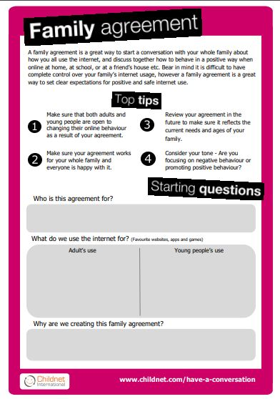
How to create and maintain media rules and behaviour for your family
Childnet International family media agreement and advice.
Themes: keeping safe, social networking, gaming and toys.
Notes:
Hand out the family media agreements and advice sheets so that parents and carers have guidelines.
The facilitator can take a few minutes to review the Childnet advice sheet – which provides advice on how to successfully create and maintain media rules and behaviours for families.
Parents and carers should keep in mind that the agreements can and will change as your child/children in primary school mature.
The first family media agreements may be very restrictive in order to prevent young children from having free access to social media and/or video gaming sites.

Slide 24
Resources
Childnet International – a range of resources for primary and secondary schools, children and young people, teachers and parents/carers
Meic – the Welsh Government-funded bilingual national advocacy service for children and young people in Wales
Notes:
Childnet International – http://www.childnet.com/ – a range of resources for primary and secondary schools, children and young people, teachers and parents/carers.
Meic – http://www.meiccymru.org/ – the Welsh Government-funded bilingual national advocacy service for children and young people in Wales.
These resources will be included in the resource sheet.
Question: ask parents and carers what other resources they know, have shared with their child/children, and what was effective.

Slide 25
Thank you!
Before you go:
Don’t forget to stay involved in their child/children’s online activities
Check out the Online Safety Zone for more resources
Notes:
End the session with a reminder to stay involved in their child’s/children’s online activities.
Ensure the parents and carers know they can go to the Hwb Online Safety Zone– https://hwb.gov.wales/onlinesafety for more information.
Hand out resource and tip sheets.

